Slide 1

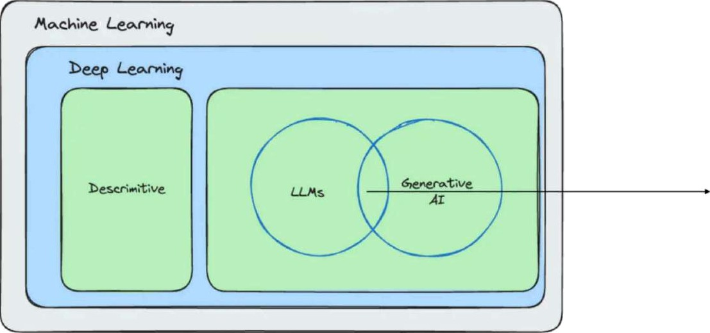
What is Artificial Intelligence (AI)?
GerrÎini
Intelligent Applications with Spring AI

Slide 2
Examples ...
Query data with natural language
  “Wh)y’did the user oks For their occount to 6e closed?”
    Checks emails, complaints, logs, customer support tickets, social media etc.
Intelligent Applications with Spring AI
12

Slide 3
Examples
Perform aggregation and transformation
  Summarize text
° Extract action items
  Censor/identify sensitive data or a buse
° Translate to diPerent languages
lZ

Slide 4
Exam pies .,.
Manipulate data
» “Reoctivote customer occount ond noti/\' them by email.”
Define and execute business rules
o ^{f}’/Fcustomer hos not logged in for 6 months, send o reminder.“
Generate code
› “Create a CSV exporter for off orders and write tests for it.”

Slide 5
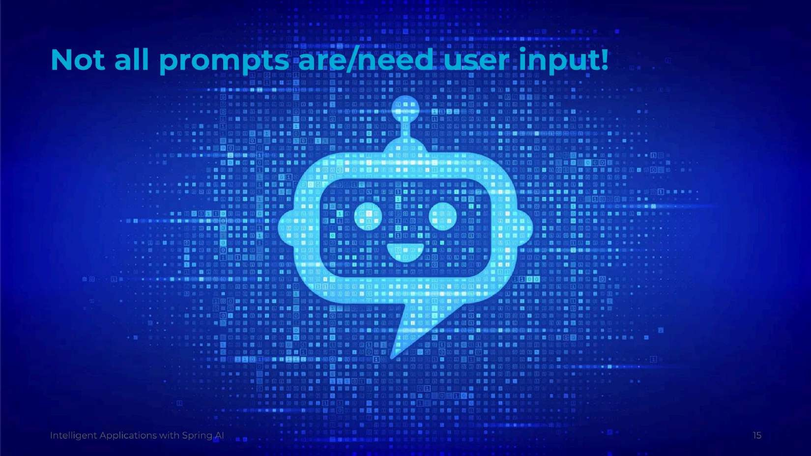

Slide 6
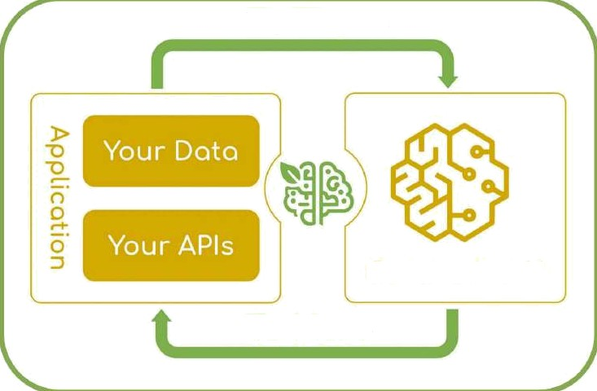
To There
Generotive Al
To Here
This is an integration problem!
Intelligent Applications with Spring AI
17

Slide 7


Slide 8
#! /us r/b1n/env bash
echo "Calling OpenAI API ..."
PR0NPT="Te II me a I r1 end Iy developer j oke about JAVA. "
curl https://api.openai.com/v1/chat/completions \
H "Conten t - Type: app11cat1on/j son" X
-H "Authorization: Bearer $SPRING_AI_OPENAI_API_KEY" \
- data
\“model\”: \"gpt-3.5-turbo\",
\“messages\“: [
\”role\": \"system\",
\"content\": \"You are a friendly chatbot and you like to place emojis everywhere.\"
\”role\": \"user\",
\”content\“: \”$PR0MPT\"
Intelligent Applications with Spring AI
19

Slide 9


Slide 10





Input Types
Output Types
Language / Code
Language / Code
Images (Multi-Modal)
Language / Image
Image
Audio
Language
Language
Audio
Text / Image
Vector/Embedding
See.' zhnci /: Hi- reel,
Al

Slide 11

LLM Leaderboard - Comparison or GPT-4o, Llama 3, Mistral, Gemin i and over 30 models
INOEX
MEDIAH .
MEDtAN
FURTHER
@I0oefiAI
12Bk
77
M 3B
106.0
O.4O
GPT-alo
S?.SO
103.2
O.dO
929k
71
60.26
O.d1
Oama3d 05B
00 Meto
8O.P0
53.0
O.4S
LO Meto
sz
O3S
Google
7Z
61.6
0.92
Oo' 'gle
6D
2O'/9
0.39
Gov.gue
8B 80
686
0u3
8k
a7
$O.2G
0.33
7D
sa,oo
Z6.6

Slide 12
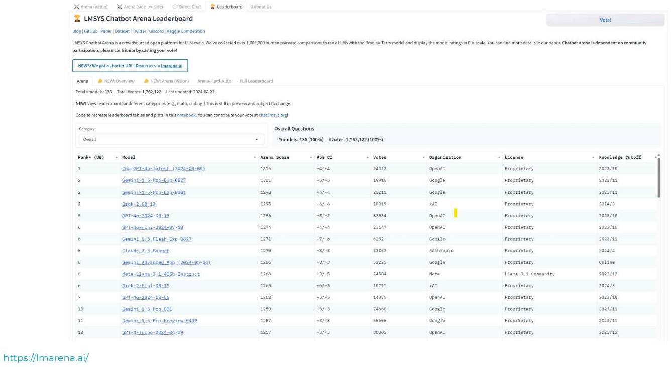

Slide 13


Slide 14
Integrating Custom Data & APis
How can you equip the AI model with information on which it has not been
trained? GPT-3.5/4.0 only has knowledge up until 3une 2024*, limiting its ability to answer questions about more recent data.
* Why not asking Chat GPT with a prompt?
You sald:
Can you tell me the date of the most recent information in your training data?
ChatGPT said:
My most recent training data goes up until June 2024. However, I can fetch up-to-date information from the web if needed. Let me know how I can help!
Intelligent Applications with Spring AI
28

Slide 15
Limitations of Al Models
Al models:
Are trained on public knowledge up to a certain date
They don't know about your private / corporate data
Don't have access to realtime data
Can't learn from your data

Slide 16
Bring Vour Own Data
Ways of using your data in AI applications:
Train new models (X)
Fine tune existing models (X)
"StuP the prompt" ( ...’)
Retrieval Augmented Generation ( )
Function calling (/.:. )
Al

Slide 17

3a'va and AI
AI becomes ubiquitous across the IT landscape
Java is the language of enterprise
Creating Java AI apps is a new requirement
Spring AI, LangChain4j, Semantic Kernel
  Simplify AI integration
  Provide a unified API
  Support multiple AI providers

Slide 18

Spring Al
spring”A/
See Spring AI on GitHub or on sprİng,lo.
Intelligent Applications with Spring AI
57

Slide 19
What is Spring AI?
Al for 3ava developers!
Simplifies interactions with LLMs with a Spring abstraction
° Change model by changing one line of configuration!
Simplifies interactions with Vector databases
Observability
ChatMemory
And more ...

Slide 20
Spring AI Ecosystem
Created in 2023 by Mark Pollack and Christian Tzolov
Inspired by LangChain and Llamalndex
Current version: Spring AI J.0.0-M5
Not in a final release version ye\!
Based on Spring Framework 6.1 and Spring Boot 3.3

Slide 21
Spring lnitializr
Head on over to start.spring io and select the Al Models and Vector Stores that you want to use in your new applications.
Web. Security. UPS, Ac!ug fior. Deuto‹als
Press Ctrl for mtiJtiple adris
Azure OpenAl
Spr ng AI support for Azure s OpenAl o!fenng, powered by ChatGPT. It extends heyond traditional OpenAl capabilit-'es. rlelivering Al-driven text generation with enhanced functionalily.
Azure AI Search
Spring AI voclor database support for Azuro AI Soarch. li 's an Al-powo ad information retrioval platform and
part nl Mirrosoft's larger d | platform Among other fmat‹ires, ii aIInws users tc qr ery information using vrrtor- based storage and rely ieval.
Amazon Bedrock
Spring AI support for Amazon Be¢irock. It is a manaCed service that provides Foundation models from various AI providers. available through a unified API.
Chroma Vector Database
Spring AI vector dstabsse support for Chroma. It is an open-source embedding database and gives you the lools \o store document embeddings, content. and me\adata. It also allows to search through those embeddinqs. including metadata fiiterng.
Milvus Vector Database
Spring AI vec\or database srippon for Milvus. It is an open-source vector aatabase that has ganJered

Slide 22
Milestone Repository
Because Spring AI is still in Milestone, you need to add the Spring Milestones repository to your porn. xml file. From MS onwards, they are also in Maven
Central.
<repos1tor 1es>
<repos1tor y>
<1d>spr1ng -«i11estenes</1d>
<nai›ie>spr1ng N1testones</name>
<ur 1>ht tps : //repo . spr1ng . 1o/m1Iestene</urt>
snapshots
<enab1ed>fa1se</enabled»
</snapshots>
</repos1tory>
</repos1tor1es>
Intelligent Applications with Spring AI
42

Slide 23
Spring AI BOM
Add the Spring AI BOM to your pom . xml file and reference the version in the properties section.
‹propertiesx
spring-ai.version 1.0.0-M5 /spring-ai.version
/properties
<dependencyManagement>
<dependenc 1es>
<dependency>
<g roupI d>or g . sp r1ngf r amewor k . a1</g roupI d>
<ar I 1fac tI d>spr1ng -at- bom</art1fact Id>
<vers1on>${sp r1ng -a1 . vers1on}</vers1on>
<type>pom</type>
<scope>1mport</scope>
</dependency>
</dependencies>
/dependencyManagement>
Intelligent Applications with Sprinp AI
43

Slide 24
Spring Boot Starter
Add the specific Spring AI dependency to your pom. xml file.
<dependency>
<groupId>or g . spr1ngf r amexer k . a1</g reupld>
<artifactId spring-ai-openai-spring-boot-starter /artifactId
</dependency
Then, you can configure model parameters in the app fication. properties file as follows:
spring.ai.openai.api-key=$(SPRING_AI_OPENAI_API_KEY}
spring.ai.openai.chat.options.model=gtp-4-turbo
Intelligent Applications with Spring AI

Slide 25
Prompt Templates
Using the StringTemplate Engine
5t r1ng res sage -
List 10 of the most popular YouTubers in (genre}, along with their current subscriber
If you don ' I know I he answer , j us t say "I don ' I k now" .
PromptTemplate promptTemplate = new PromptTemplate(message); Prompt prompt promptTemplate.create(Map.of(”genre”, genre)};
numbers.
String answer = chatClient.prompt(prompt).call().content();
ChatResponse response chatClient.prompt(prompt).call().chatResponse();
String answer = response.getResuIt().getOutput().getContent();
Intelligent Applications with Sprinp AI
46

Slide 26
Chat Ciient
Joke j oke = chatC t1ent . prompt( )
. user ( ”Tell me a I r1 end1y developer
. call( )
.content( ) ;
j oke about JAVA . " )
Joke joke = chatClient.prompt()
.system("You are a friendly chatbot and you like to place emojis everywhere.”)
. use r( ”Tell «ie a I r1end1y developer j oke about JAVA . " )
. call( )
.en1t ty( 3oke . class) ;
Chatolient chatClient = chatDlientBuilder
.defauItSystem("You are a friendly chatbot and you like to place emojis everywhere.")
.build();
Intelligent Applications with Spring AI
47

Slide 27
Request Response
Based on OpenAl chat model:
Request
° model
° list of messages, each with a role and content
Response
o model
° list of choices, each with a message
° finish reason
t usage, with the number of tokens used

Slide 28


Working with Imag es
! Valk e ( "c tas spa t I : iarges/ t cc kl›o tm -bear he i . pncg " ) private Resource izageResour ceUeat her ;
.media(MimeTypeUtils.IMAGE PNGf
. call( ) . content ( ) ;
s.imageResourceWeather))
_{°F} Niederschlag: 3Sf
Lriftfetichte 82%L
Wetter
Mittwoch, 05:00 Stark bewöl<t
°c

Slide 29
Working with Audio Transcription Model
transcriptionModel.call(new AudioTranscriptionPrompt(audioFile)).getResult().get0utput();
var transcriptionResponse transcriptionModel.call(new AudioTranscriptionPrompt(audiorile,
0penA1Aud1oT ransc r1pt1on0pt1ons . bu1lder ( )
. language( "en" )
.prompt(”Transcribe the audio file about Philipp Maloney and the missing
.temperature(0f)
.responseFormat(0penAiAudioApi.TranscriptResponseFormat.VTT)
bag.”)
.build()));
return transcriptionResponse.getResu1t().getoutput();
HEBVTT 00:00:01.000 --> 00:00:04.000 Philipp Maloney's hair-raising cases 00:00:05.000 --> 00:00:08.000 The hair-raising cases of Philipp Mahoney. 00:00:09.000 --> 00:00:11.000 Today, the missing bag.
00:00:24.000 --> 00:00:28.000 The man sounded confused and excited at the same time on the phone.
00:00:28.000 --> 00:00:33.000 His voice sounded familiar, but I couldn't classify it.
00:00:33.000 --> 00:00:36.000 0nIy when I saw him did I recognize him. 00:00:36.000 --> 00:00:40.000 And then it was too late to run away.
00:00:40.000 --> 00:00:42.000 Do you remember me?

Slide 30

Working with Audio Speech Model
speechModel.cam( ew Spe‹ichPromg:(resource.getContentAsString(Charset.defau{tCharset()))).getResu{t().getoutput();
va i speec lake s hon se speechXode 1. cat I( new
_{r}e C _{P} “_{C’}i»g t ( resource , get Content AsS t r1ng ( Char se t . defau It Char se I ( ) ) ,
0penA1Aud1oSpeech0pt ions . but Tde r ( )
. nodet( " t s - J " )
.voice(openAiAudioApi.SpeechRequest.Voice.SHIMMER) responseFormat(0penAiAudioApi.SpeechRequest.AudioResponseFormat.MP3)
.speed(1.3f)
build()));
return speechResponse.getResuit().get0utput();
0 localhost:8080/original
+
— EJ
X
+
,¿, @
W @
localhost:8080... @
@ @
"
)
0:02/0:42

Slide 31
Retrieval Augmented Generation
Bring your own data to the prompt
Give a lot of context to the prompt
  Text content, vectors etc.

Slide 32
Prom pt Data Ta kes Precedence (1)
You said:
How many sports were there in the Paris Olympics?
ChatGPT said:
For the 2024 Paris Olympics, there are 32 sports featured, with a total of 329 events. New additions include breaking (breakdancing), and skateboarding, sport climbing,
and surfing are also returning after debuting in Tokyo 2020.
Int i¿w ?Aquhc1.’>Jsa U Zq0r:qñI
5G

Slide 33
Prompt Data Takes Precedence (2)
You said:
Here are the sports for the Paris Olympics: Archery, Athletics, Badminton, Basketball, Basketball 3x3, Boxing, Canoe slalom, Canoe Sprint, Road Cycling, Track Cycling, Mountain Biking, and BMX.
How many sports were there?
ChatGPT sald :
Based on the list you provided, there are 12 sports for the Paris Olympics,
57

Slide 34
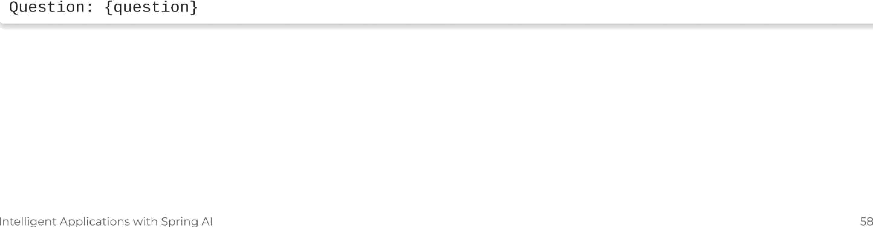
Prom pt Stuffing Structure
@Val1e(”classpath:/olymuicsZcontext.s ”) private Resource queryTemplate;
Use the following pieces of context to answer the question at the end.
{contex t}

Slide 35
Using a Stuffed Prompt
chatClient.prompt()
.user( userspec - userspec.text(this.queryTemplate)
.param( "context" , "Archery, athletics, badminton, basketball , boxing")
.param( "question" ,"How many sports are being included in the 2024 summer Olympics?”)
. call( ) .content( ) ;
Use the following pieces of context to answer the question at the end.
Archery, athletics, badminton, basketball , boxing
Question: How many sports are being included in the 2024 Summer Olympics
Intelligent Applications with Sprinp AI
59

Slide 36
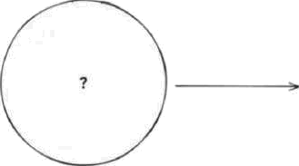
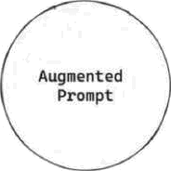


Application Architecture - RAG
,.. on
Intelligent Applications with Spring AI
60

Slide 37
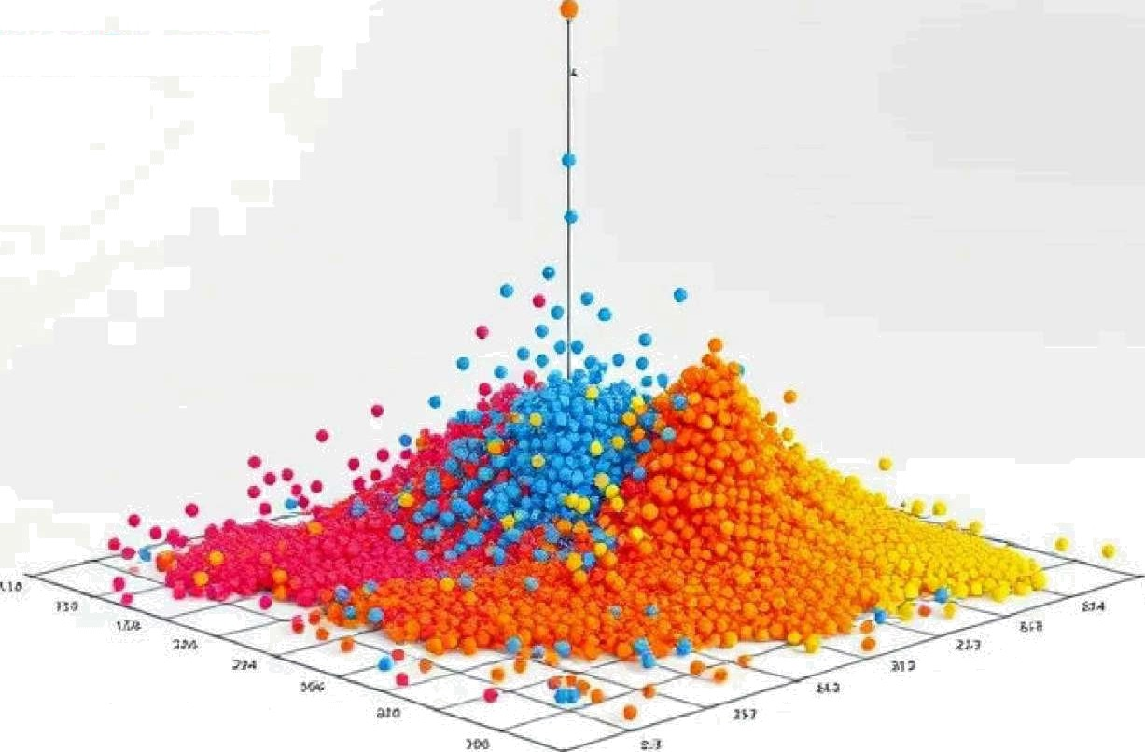



Intelligent Applications with Spring AI
62

Slide 38
Definition of a Vector
A Vector isjust a type of data
  Typically an array of floating-point numbers
° Commonly consists of J'536 decimal values
    OpenAl uses the adaOO2 embedding model
° Each value typically ranges between -1 and 1
CREATE TABLE paragraph ( id SERIAL PRINARY KEY,
par agr aph text TEXT,
vecto r VECTOR{1536)
Example: {- ô . 345,
ô . 465,
ö . 856,
. , ö . 1543}
Intelligent Applications with Spring AI
63

Slide 39
How are Vectors created?
Vectors typically represent the output generated by machine learning models, encapsulating the learned features or embeddings of the input data.
The example below is based on text AI models. Vectors may also be used with computer vision AI models or audio-based AI model
Vector
{0.345, 0.465, 0.B56, 0.1543]
string
"My house is black" "My garden is big" "My dog is playful"
{0.545, 0.665, 0.056, 0.3543)
(0.645, 0.76S, 0.1S6, 0.4543]
Intelligent Applications with Spring AI
64

Slide 40
Simila rity Search
Selects the closest vectors to a given vector
{ - ó . 436, ó . 578, ó . 935, ó . 2193)
Vector
(0.345, —0.465, 0.85 6, O.15ó-Z}
{-0.44S, 0.565, 0.9S6, 0.2543)
(0.545, 0.665, 0.056, 0.3 543)
(0.645, 0.765, 0.156, -0.4543}
(0.745, 0.865, 0.2 56, 0.5 5'\3)
(O.8‹5, O.965, -O.ZS 6, 0.6S< 3j
I i Le ic e: 6. u lisa !.” iJs \°.' L11 Ü ! i r ej I

Slide 41





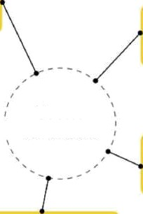








o 0 en
- elasticsearch
VUS
(w)
Weoviofe
Open Source
é • Pinecone
Vector Databases
Annoy
redis
mongoDB.
FAISS
Pgvector for Postgres
In Leliigent ApplicationS vv!tf1 Shri nq AI
G6

Slide 42
Using a Vector Store
@VaIue("Artificial intelligence - Wikipedia.pdf”)
private Resource pdf;
PagePdfDocumentReade r reade r new PagePdfDocuuentReader (pdf) ;
TokenTextsplitter splitter = new TokenTextSplitter(); List Document documents = splitter.apply(reader.get()); vectorstore.accept(documents);
String answer = chatClient.prompt()
.system(”””
You are a virtual assistant and answers questions with the data
If you are not sure or don't know, honestly say you don't know.
provided.
.user("Why is the definition of AI difficult?“)
.advisors(new QuestionAnswerAdvisor(vector5tore))
. call( )
.content ( ) ;
log . 1nfo( "Chat GPT answe red : {}", answer ) ;

Slide 43
Registering Custom Functions
The model generates a 3SON object with arguments for the registered functions.
The model does not call the function directly.
Vour code executes the function, and the result is returned to the model.

Slide 44




Your code
LLM
1. Your application calls the API with your prompt and definitions of the functions the LLM can call
2. The model decides whether to respond to the user or whether one or more functions should be called
3. The API responds to your application specifying the function to be called and the arguments to call it with
4. Your application executes the function with the given arguments
5. Your application calls the API providing your prompt and the result of the function call your code just executed

Slide 45
Function Calling
gBean
// Reques I anno ta ted u1th I JsonC I assDescr1p II on and JsonPrope r tyDescr1p tion
public Function WeatherService.Request, WeatherService.Response» weatherFunction() {
return new WeatherService();
String answer = chatCIient.prompt()
.user("What's the weather like in Stockholm, Zurich,
. f unc t 1ans( "weat herFunc t1on" )
. call( )
.content ( ) ;
log . 1nfo( "Chat GPT answe red : {}", answer ) ;
and New York?”)
Intelligent Applications with Spring AI

Slide 46
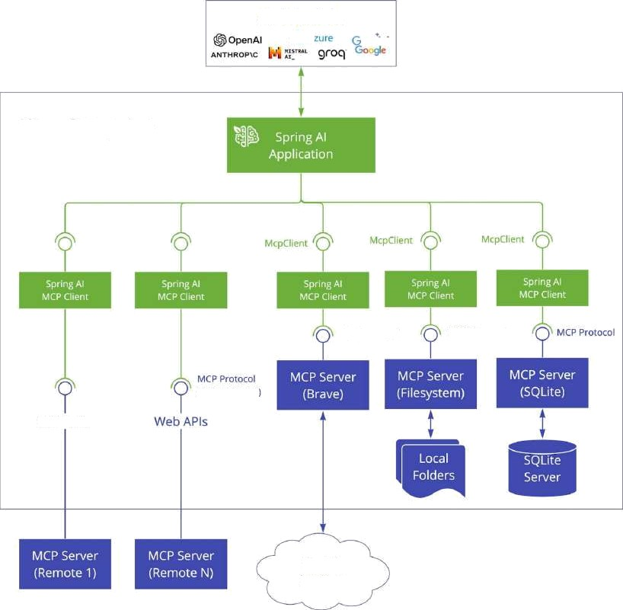

AI Models
emn
Your Computer
MCP Protocol
MCP Protocol
tssfi transport
Web APIs
Search Internet
Intelligent Applications with Spring AI

Slide 47
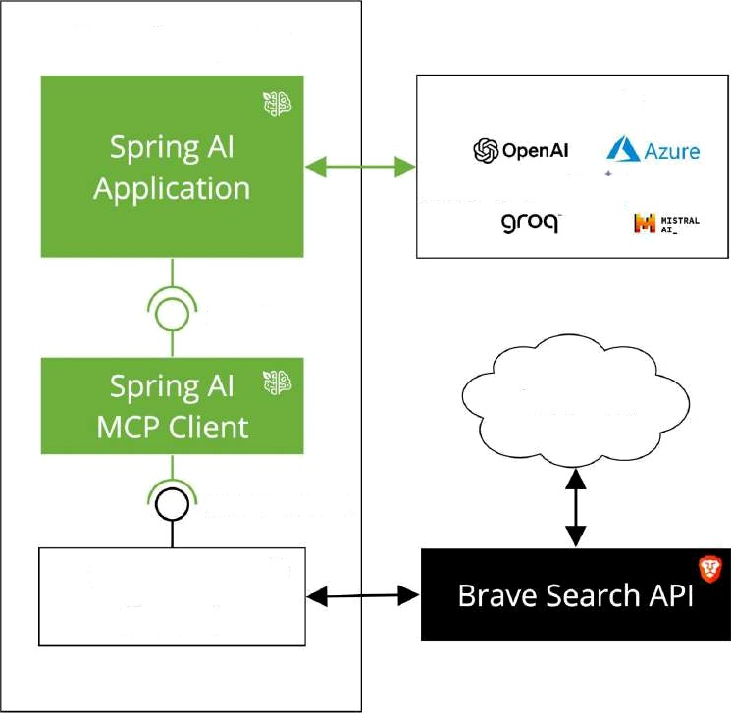
Your Computer
AI Models
ANTHROP\C
Gemini
Goog
McpClient
Internet
MCP Protocol
MCP Server 4’
(Brave)
Intelligent Applications with Spring AI
74

Slide 48
Model Contexî Protocoİ (MCP)
// hI tps ://g1 thub . commode Icontex ip rotoco I/servers/ t ree/na1n/src/brave - sea rch
var stdioPar acs = ServerParameter s . bui lder ( "npx" )
.args("-y", "8modelcontextprotocol/server-brave-search")
. addEnvVar ( "eRAVE_API_KEY", system . getenv( "BRAVE_AP I_KEY" ) )
.build();
var mcpClient = NcpClient.sync(new StdioCłientTransport(stdioParams)).build();
var init = mcpClient.initialize();
var chatCl1ent = chatCIientBuitder
.defaultFunctions(mcpClient.listTools(nułl)
.tools()
.stream()
.map(tooł -
new McpFunctiunûallback(mcpClient, tool))
. toArray(ncpFunctżonCat1back[] : new) )
. build( ) ;
Intelligent Applications with Spring AI
75

Slide 49
Generative AI Challenges
Challenges
Align responses to goals
No structured output Not trained on your data Limited context size Stateless APis
Not aware of your APis
Integration of standard APis Hallucinations
Intelligent Applications with Spring AI
Patterns System prompts
Output converters Prompt stuPing RAG
Chat Memory
Function calling
Model Context Protocol (MCP) Evaluators

